Slide 1

Reliability Assessment of Multiple Component Systems Using Bayesian Hierarchical Models
James Gilman
7 June, 2017

Slide 2
Contributors
Kassandra Fronczyk
Lawrence Livermore National Laboratory
Alyson Wilson
North Carolina State University
Caleb Browning
North Carolina State University
Laura Freeman
Institute for Defense Analyses
Rebecca Dickinson
Institute for Defense Analyses
Notes:
I am not the only one working on this project
List of my fellow collaborators

Slide 3
Outline
Overview
JLTV case study
Bayesian reliability approach
Assurance test planning
Future work

Slide 4



Large Scale Acquisition Process
Products can have many components all with specific requirements
Developmental milestones are used before large scale production
Multiple stages of testing and evaluation
Testing and evaluation cost are non-trivial
Both producers and consumers accept some risk in the process
Notes:
Setting up the problem
Developmental stages, back and forth between test
Cost : both test and investment -> efficient and accurate testing being important
Risk on both sides
Examples in Space Crafts, Healthcare, Military

Slide 5
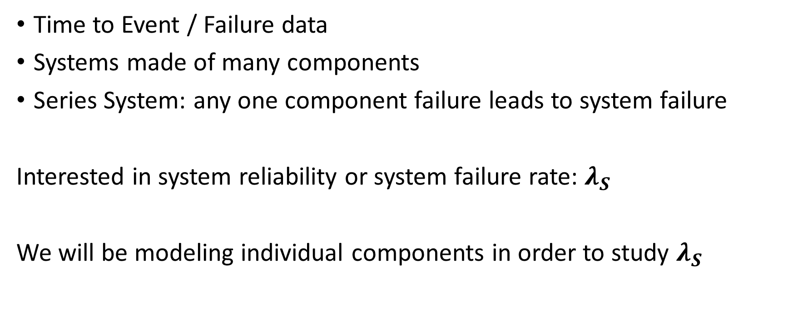
Reliability of Multiple Component Systems
Time to Event / Failure data
Systems made of many components
Series System: any one component failure leads to system failure
Interested in system reliability or system failure rate: $λ_{S}$
We will be modeling individual components in order to study $λ_{S}$

Slide 6
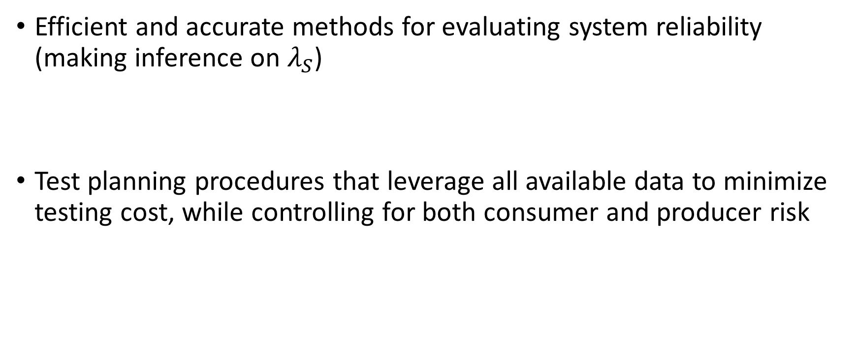
Goals
Efficient and accurate methods for evaluating system reliability (making inference on $λ_{S}$)
Test planning procedures that leverage all available data to minimize testing cost, while controlling for both consumer and producer risk
Notes:
Cut this slide if needed

Slide 7



Case Study: JLTV
Department of Defense will be replacing the legacy Humvee vehicle fleet with the Joint Light Tactical Vehicle (JLTV) Family
Eight prototypes have gone through a series of three developmental testing phases
Testing required vendors conduct 160,000 miles of reliability testing

Slide 8


Developmental Test
8 Vehicle variants
Variants based on different military needs (e.g., combat, sustainment, police action, peace-keeping, and security patrol)
Different variants share common components such as brakes and radios.
3 Phases of testing
Location and test length change between phases
Vendors make adjustments / improvements between phases
26 Component failures were identified
Aberdeen Proving Ground
Yuma Proving Ground
Notes:
Pointing out the features of the test and where sources of variation are.

Slide 9
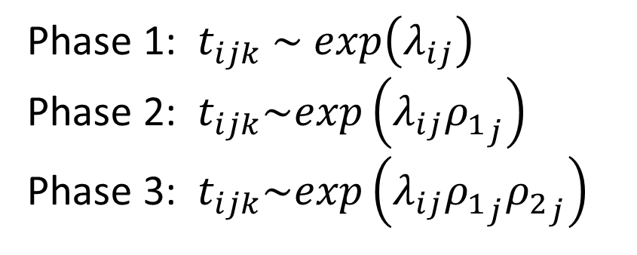
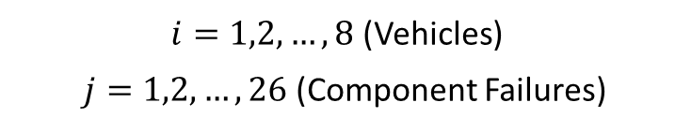
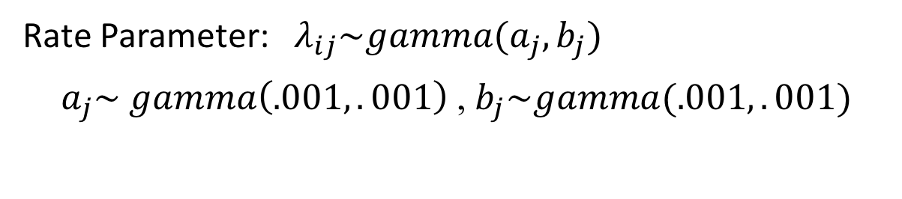

Bayesian Hierarchical Model Exponential
Phase 1: $t_{ijk} \sim exp\left(λ_{ij}\right)$
Phase 2: $t_{ijk}\sim exp\left(λ_{ij}{ρ_{1}}_{j}\right)$
Phase 3: $t_{ijk}\sim exp\left(λ_{ij}{ρ_{1}}_{j}{ρ_{2}}_{j}\right)$
$i=1,2,…,8$ (Vehicles)
$j=1,2,…,26$ (Component Failures)
Rate Parameter: $λ_{ij}\sim gamma(a_{j},b_{j})$
$a_{j}\sim gamma\left(.001,.001\right)$ ,${ b}_{j}\sim gamma(.001,.001)$
Growth Parameters: ${ρ_{1}}_{j}\sim gamma\left(c,d\right)$
${ρ_{2}}_{j}\sim gamma\left(c,d\right)$
Notes:
The Rate parameter and what it means
Common components across vehicles
Bayesian version of random effects model
Growth parameters: we expect reliability to improve between phases

Slide 10
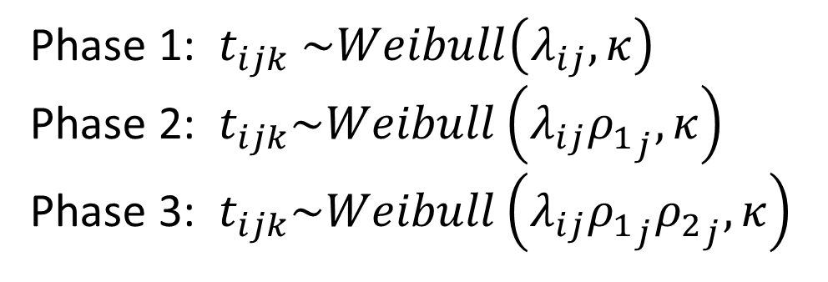
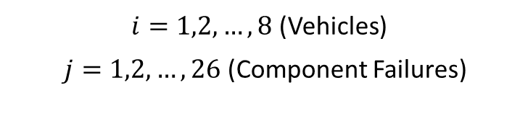
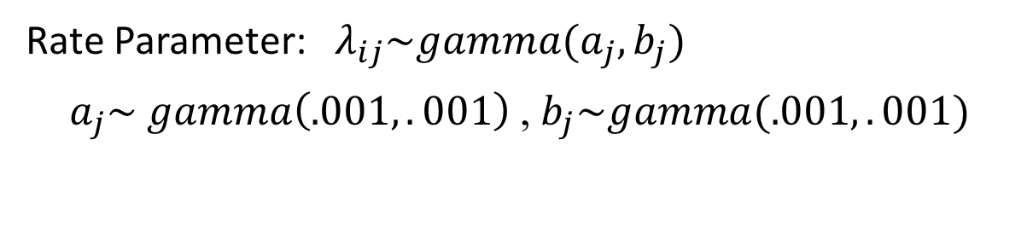

Bayesian Hierarchical Model Weibull
Phase 1: $t_{ijk} \sim Weibull\left(λ_{ij},κ\right)$
Phase 2: $t_{ijk}\sim Weibull\left(λ_{ij}{ρ_{1}}_{j},κ\right)$
Phase 3: $t_{ijk}\sim Weibull\left(λ_{ij}{ρ_{1}}_{j}{ρ_{2}}_{j},κ\right)$
$i=1,2,…,8$ (Vehicles)
$j=1,2,…,26$ (Component Failures)
Rate Parameter: $λ_{ij}\sim gamma(a_{j},b_{j})$
$a_{j}\sim gamma\left(.001,.001\right)$ ,${ b}_{j}\sim gamma(.001,.001)$
Growth Parameters: ${ρ_{1}}_{j}\sim gamma\left(c,d\right)$
${ρ_{2}}_{j}\sim gamma\left(c,d\right)$
Shape Parameter: $κ\sim gamma(.001,.001)$
Notes:
Beta parameter may be indexed by failure mode

Slide 11
Goodness of Fit
Model | DIC
Single Exponential | 23258
Hierarchical Exponential | 23022
Single Weibull | 18750
Hierarchical Weibull | 18556
Hierarchical Weibull (one shape) | 18677

Slide 12
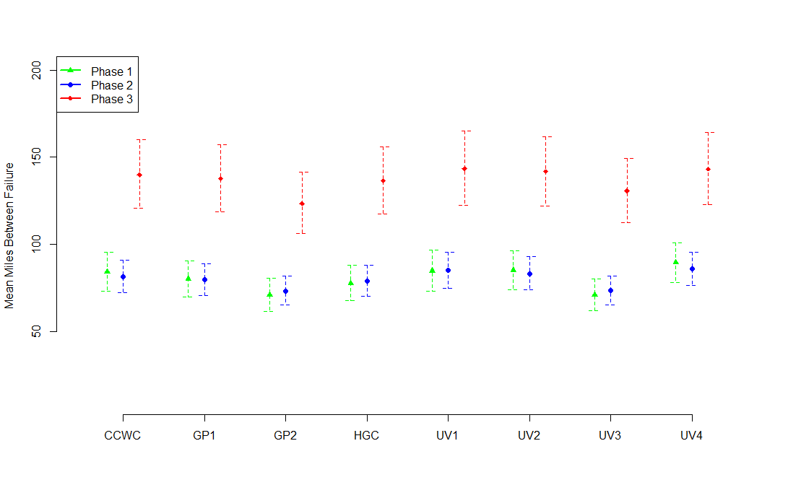
Expected Miles Between Failure 90% Posterior Intervals from Exponential Model

Slide 13
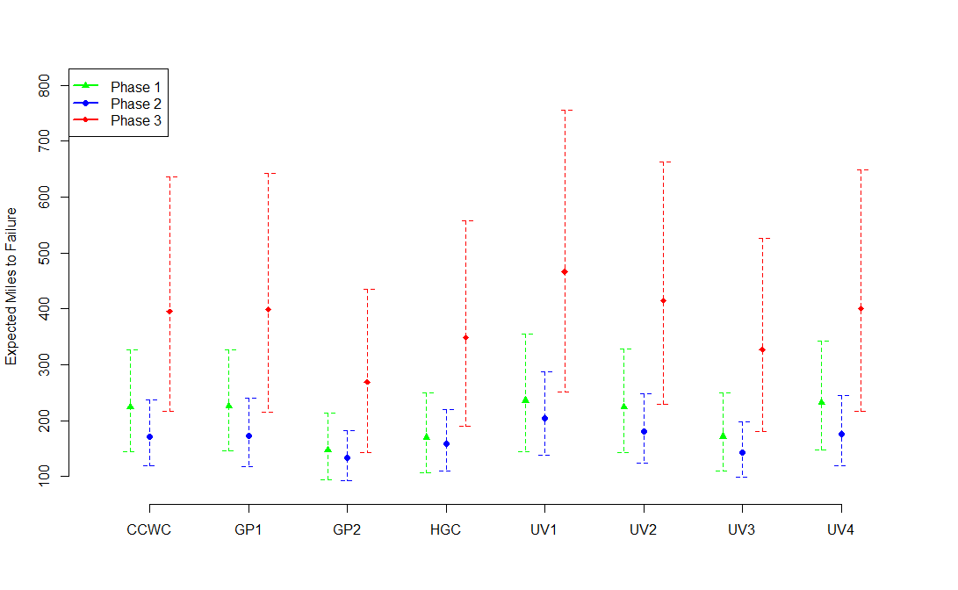
Expected Miles to Failure 90% Posterior Intervals from Weibull Model

Slide 14
Weibull with Multiple Shape Parameters 90% Intervals

Slide 15
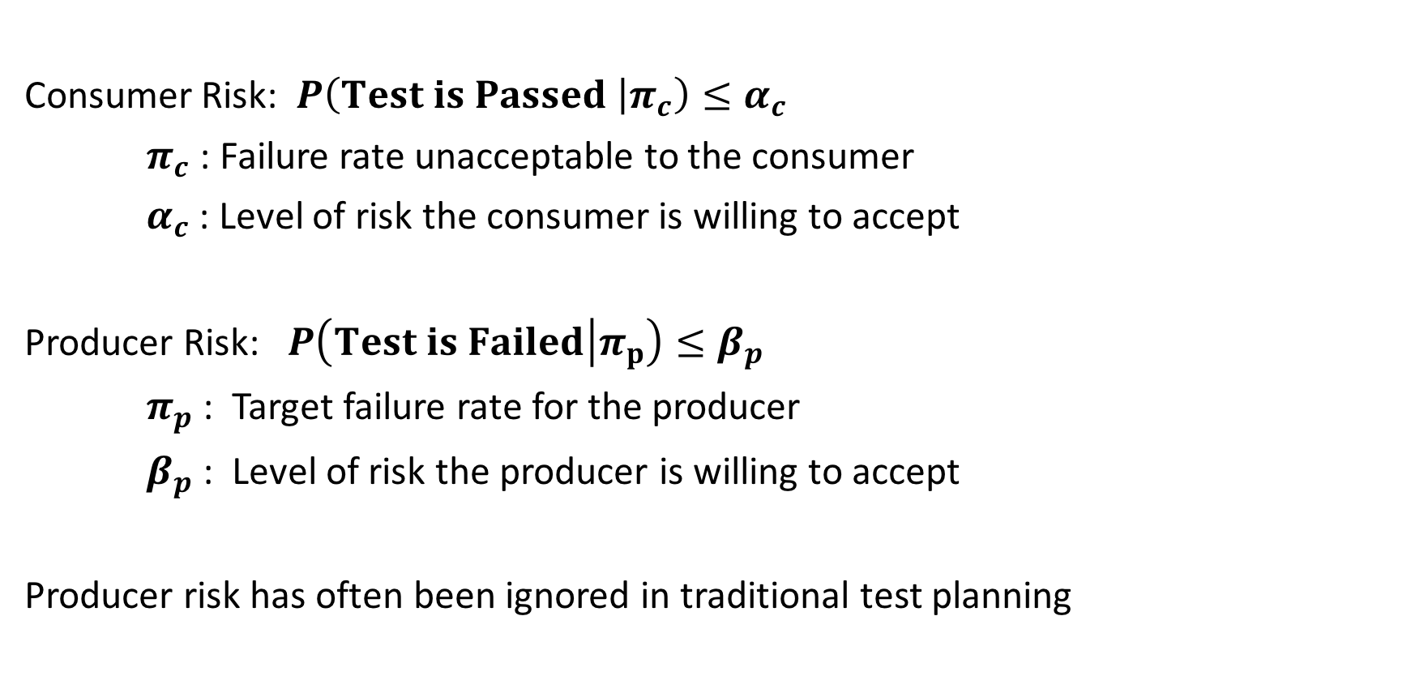
Assurance Test Planning Classical Testing
Consumer Risk: $P\left(Test is Passed | π_{c}\right)≤α_{c}$
$π_{c}$ : Failure rate unacceptable to the consumer
$α_{c}$ : Level of risk the consumer is willing to accept
Producer Risk: $P\left(Test is Failed | π_{p}\right)≤β_{p}$
$π_{p}$ : Target failure rate for the producer
$β_{p}$ : Level of risk the producer is willing to accept
Producer risk has often been ignored in traditional test planning

Slide 16
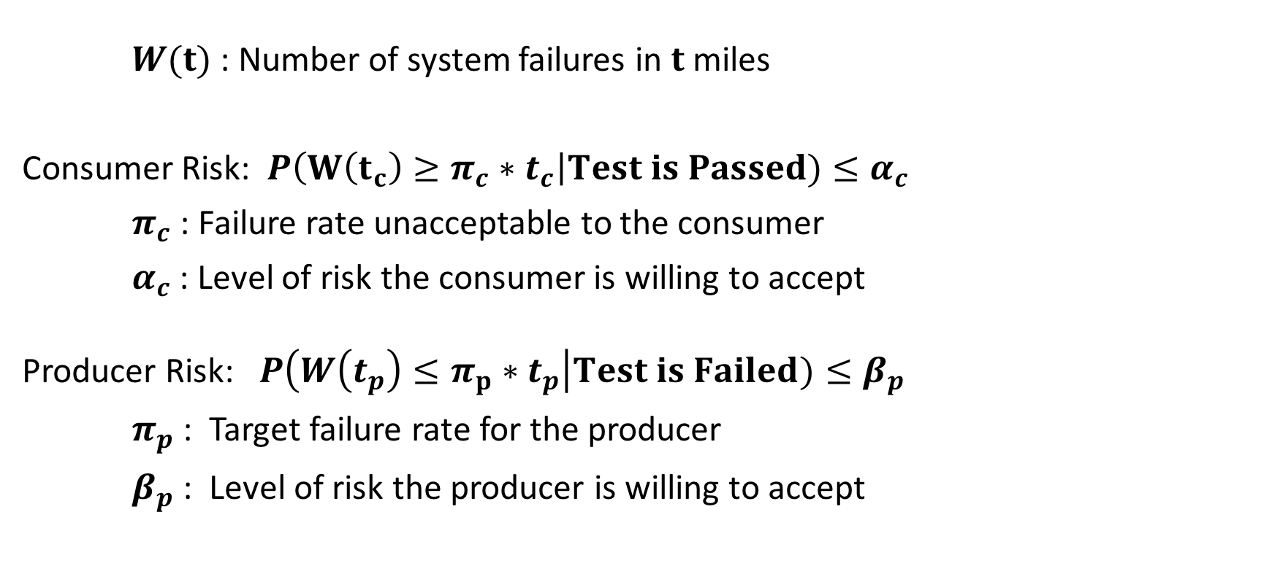
Assurance Test Planning Bayesian Testing
$W(t)$ : Number of system failures in $t$ miles
Consumer Risk: $P\left(W\left(t_{c}\right)≥π_{c}∗t_{c}\right|Test is Passed)≤α_{c}$
$π_{c}$ : Failure rate unacceptable to the consumer
$α_{c}$ : Level of risk the consumer is willing to accept
Producer Risk: $P\left(W\left(t_{p}\right)≤π_{p}∗t_{p}\right|Test is Failed)≤β_{p}$
$π_{p}$ : Target failure rate for the producer
$β_{p}$ : Level of risk the producer is willing to accept
Notes:
W(t) is treated as random
Consumer: if the test is passed we want probability the failures over time t being larger than t*pi_c to be small
Producer: if the test is failed we want prob the failures over time t is less than t*pi_p

Slide 17
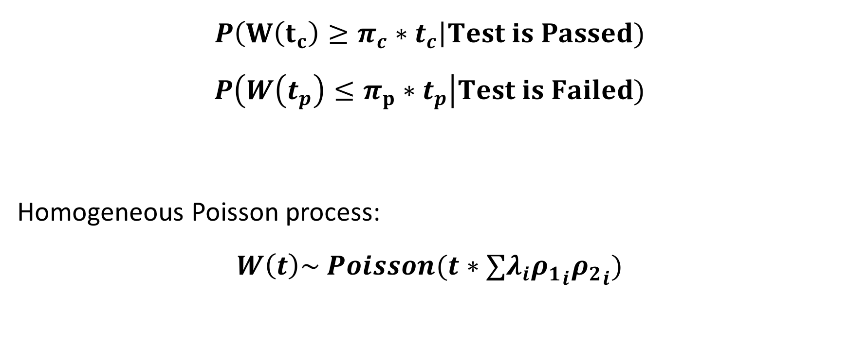
Assurance Test Planning Exponential
$$P\left(W\left(t_{c}\right)≥π_{c}∗t_{c}\right|Test is Passed)$$
$$P\left(W\left(t_{p}\right)≤π_{p}∗t_{p}\right|Test is Failed)$$
Homogeneous Poisson process:
$$W\left(t\right)\sim Poisson(t∗∑λ_{i}{ρ_{1}}_{i}{ρ_{2}}_{i})$$
Notes:
First looking at Expo setting
Want to control for both risk so must evaluate both conditional probabilities
Know W(t) is this because modeled expo

Slide 18
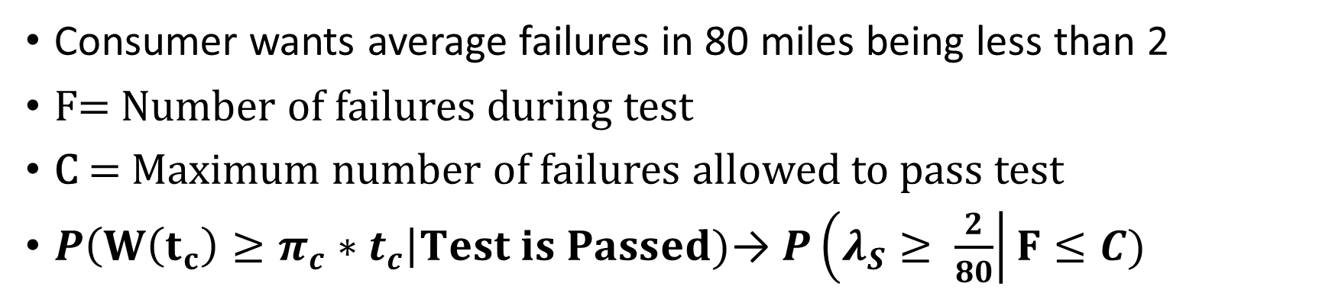
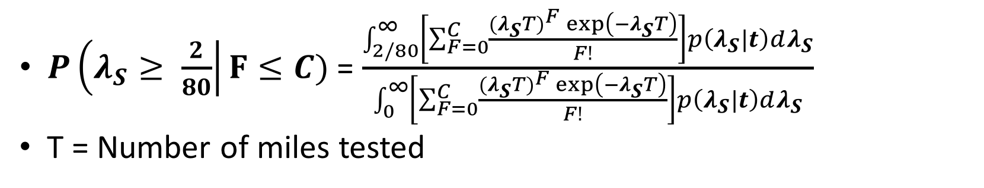
Assurance Test Planning Exponential
Consumer wants average failures in 80 miles being less than 2
F= Number of failures during test
C = Maximum number of failures allowed to pass test
$P\left(W\left(t_{c}\right)≥π_{c}∗t_{c}\right|Test is Passed)$→ $P\left(λ_{S}≥ \frac{2}{80}\right|F≤C)$
$P\left(λ_{S}≥ \frac{2}{80}\right|F≤C)$ = $\frac{\int_{2/80}^{∞}{\left[\sum_{F=0}^{C}{\frac{{{(λ}_{S}T)}^{F}\exp\left(−λ_{S}T\right)}{F!}}\right]p\left(λ_{S}|t\right)dλ_{S}}}{\int_{0}^{∞}{\left[\sum_{F=0}^{C}{\frac{{{(λ}_{S}T)}^{F}\exp\left(−λ_{S}T\right)}{F!}}\right]p\left(λ_{S}|t\right)dλ_{S}}}$
T = Number of miles tested
Notes:
We know W follows Poisson Distribution
Integrating over the posterior of our current knowledge of lambda
So we know how to evaluate this conditional probability

Slide 19
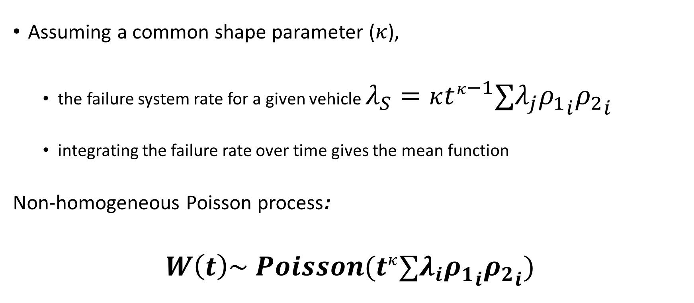
Assurance Test Planning Weibull
Assuming a common shape parameter ($κ$),
the failure system rate for a given vehicle $λ_{S}=κt^{κ−1}∑λ_{j}{ρ_{1}}_{i}{ρ_{2}}_{i}$
integrating the failure rate over time gives the mean function
Non-homogeneous Poisson process:
$$W\left(t\right)\sim Poisson(t^{κ}∑λ_{i}{ρ_{1}}_{i}{ρ_{2}}_{i})$$

Slide 20
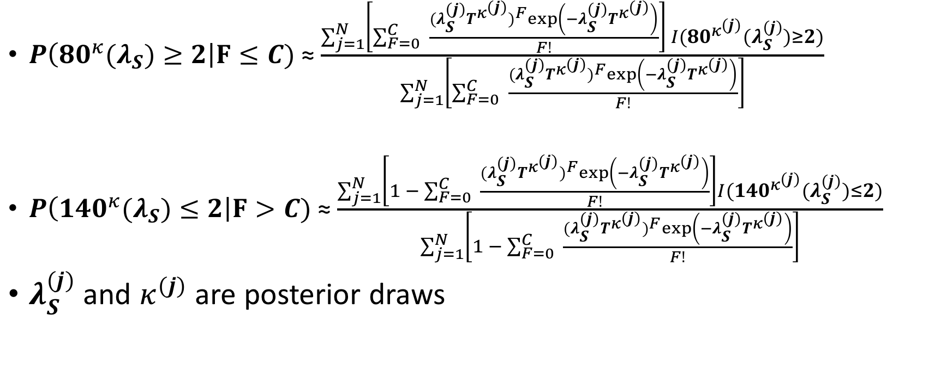
Assurance Test Planning Weibull
$P\left({80}^{κ}{(λ}_{S})≥2\right|F≤C)$ ≈ $\frac{\sum_{j=1}^{N}{\left[\sum_{F=0}^{C}{ \frac{{(λ_{S}^{(j)}T^{κ^{(j)}})}^{F}\exp\left(−λ_{S}^{(j)}T^{κ^{(j)}}\right)}{F!}}\right] I({80}^{κ^{(j)}}(λ_{S}^{(j)})≥2)}}{\sum_{j=1}^{N}{\left[\sum_{F=0}^{C}{ \frac{{(λ_{S}^{(j)}T^{κ^{(j)}})}^{F}\exp\left(−λ_{S}^{(j)}T^{κ^{(j)}}\right)}{F!}}\right]}}$
$P\left({{140}^{κ}(λ}_{S})≤2\right|F>C)$ ≈ $\frac{\sum_{j=1}^{N}{\left[1 − \sum_{F=0}^{C}{ \frac{{(λ_{S}^{(j)}T^{κ^{(j)}})}^{F}\exp\left(−λ_{S}^{(j)}T^{κ^{(j)}}\right)}{F!}}\right]I({140}^{κ^{(j)}}(λ_{S}^{(j)})≤2)}}{\sum_{j=1}^{N}{\left[1 − \sum_{F=0}^{C}{ \frac{{(λ_{S}^{(j)}T^{κ^{(j)}})}^{F}\exp\left(−λ_{S}^{(j)}T^{κ^{(j)}}\right)}{F!}}\right]}}$
$λ_{S}^{(j)}$ and $κ^{(j)}$ are posterior draws
Notes:
Would do double integration over lambda and beta, we will use posterior draws in practice

Slide 21
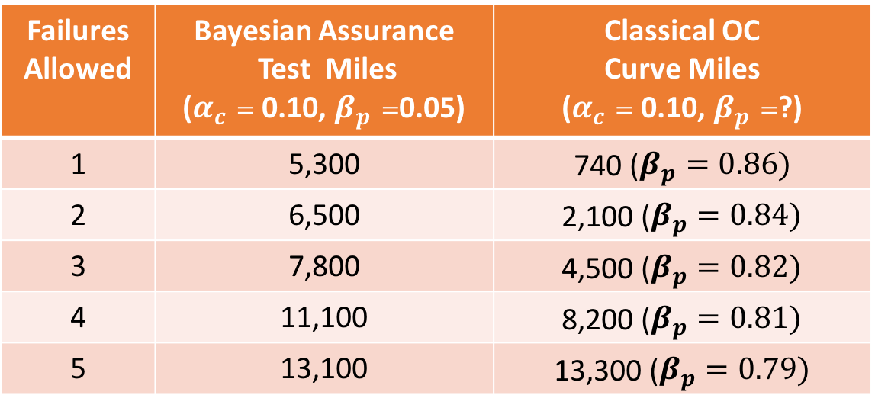
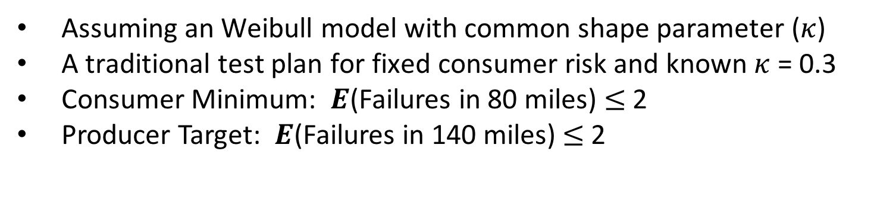
Case Study Test Plan Weibull
Assuming an Weibull model with common shape parameter ($κ$)
A traditional test plan for fixed consumer risk and known $κ$ = 0.3
Consumer Minimum: $E$(Failures in 80 miles) $≤$2
Producer Target: $E$(Failures in 140 miles) $≤$2
Failures Allowed | Bayesian Assurance Test Miles ($α_{c}=$ 0.10, $β_{p}=$0.05) | Classical OC Curve Miles ($α_{c}=$ 0.10, $β_{p}=$?)
1 | 5,300 | 740 ($β_{p}=0.86)$
2 | 6,500 | 2,100 ($β_{p}=0.84)$
3 | 7,800 | 4,500 ($β_{p}=0.82)$
4 | 11,100 | 8,200 ($β_{p}=0.81)$
5 | 13,100 | 13,300 ($β_{p}=0.79)$

Slide 22
Future Work
Using numerical methods for test planning for Weibull model with multiple shape parameters
Incorporating covariates
Vehicle variants
Test site statistics
Test planning with respect to individual components

Slide 23
Back up slides

Slide 24
Traditional Analysis
Each phase is treated independently
Different failure modes are pooled together
Exponential model
Notes:
Treating phases as independent makes sense, because of the changing factors.
Exponential model used in many reliability settings because of its simplicity even though it often does not fit the data.

Slide 25
Model Fitting
Treating component failure rates as common vs. coming from distribution
Exponential vs Weibull
Problems when misspecified
Slightly different interpretation
Failure rate is not constant over time
DIC
Posterior predictive checks
Notes:
Using exponential when Weibull with shape > 1 is true will lead to larger sample sizes than needed.
Using exponential when Weibull with shape < 1 is true will lead to test that do not meet the specified producer and consumer risk criteria

Slide 26
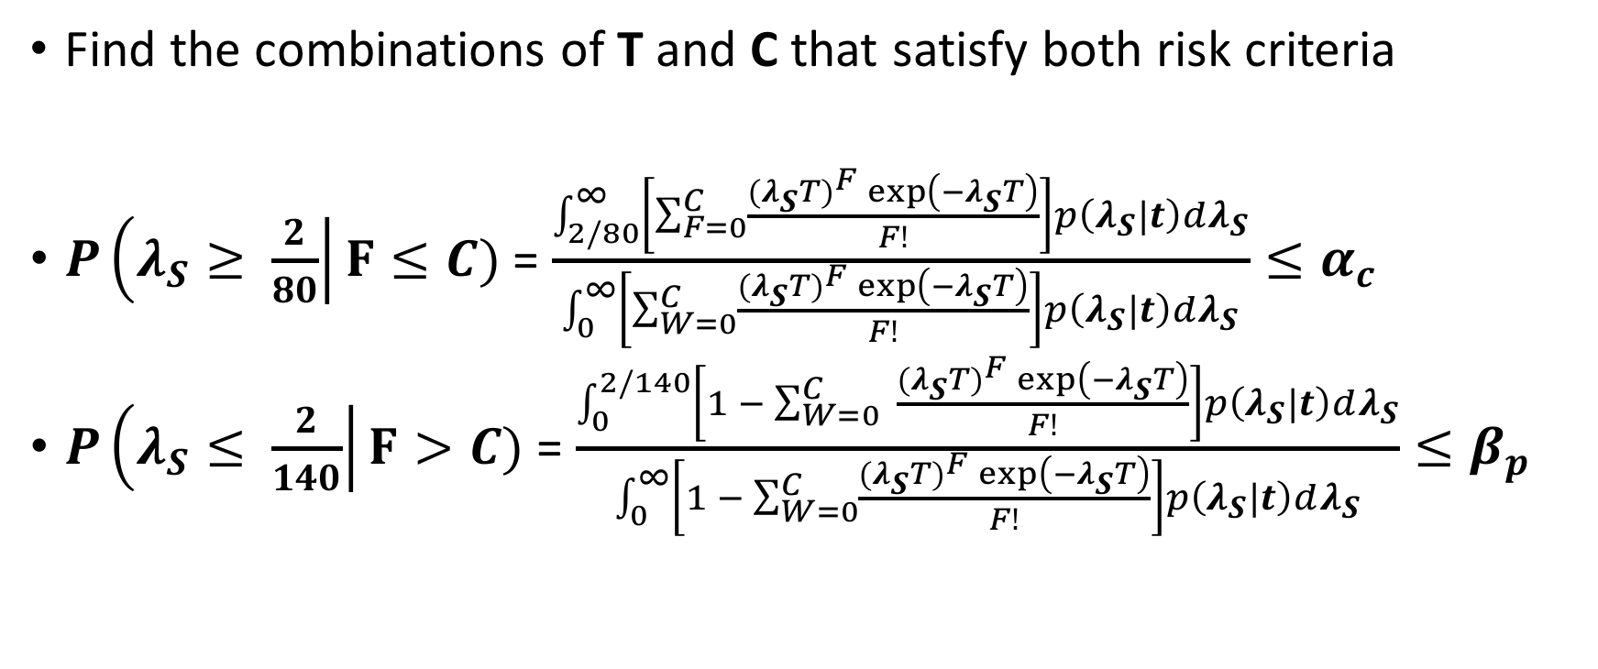
Assurance Test Planning Exponential
Find the combinations of T and C that satisfy both risk criteria
$P\left(λ_{S}≥ \frac{2}{80}\right|F≤C)$ = $\frac{\int_{2/80}^{∞}{\left[\sum_{F=0}^{C}{\frac{{{(λ}_{S}T)}^{F}\exp\left(−λ_{S}T\right)}{F!}}\right]p\left(λ_{S}|t\right)dλ_{S}}}{\int_{0}^{∞}{\left[\sum_{W=0}^{C}{\frac{{{(λ}_{S}T)}^{F}\exp\left(−λ_{S}T\right)}{F!}}\right]p\left(λ_{S}|t\right)dλ_{S}}}≤α_{c}$
$P\left(λ_{S}≤ \frac{2}{140}\right|F>C)$ = $\frac{\int_{0}^{2/140}{\left[1 − \sum_{W=0}^{C}{ \frac{{{(λ}_{S}T)}^{F}\exp\left(−λ_{S}T\right)}{F!}}\right]p\left(λ_{S}|t\right)dλ_{S}}}{\int_{0}^{∞}{\left[1 − \sum_{W=0}^{C}{\frac{{{(λ}_{S}T)}^{F}\exp\left(−λ_{S}T\right)}{F!}}\right]p\left(λ_{S}|t\right)dλ_{S}}}≤β_{p}$
Notes:
We can do the same process for the producer risk
Then we want to find combinations of T and C that satisfy both

Slide 27
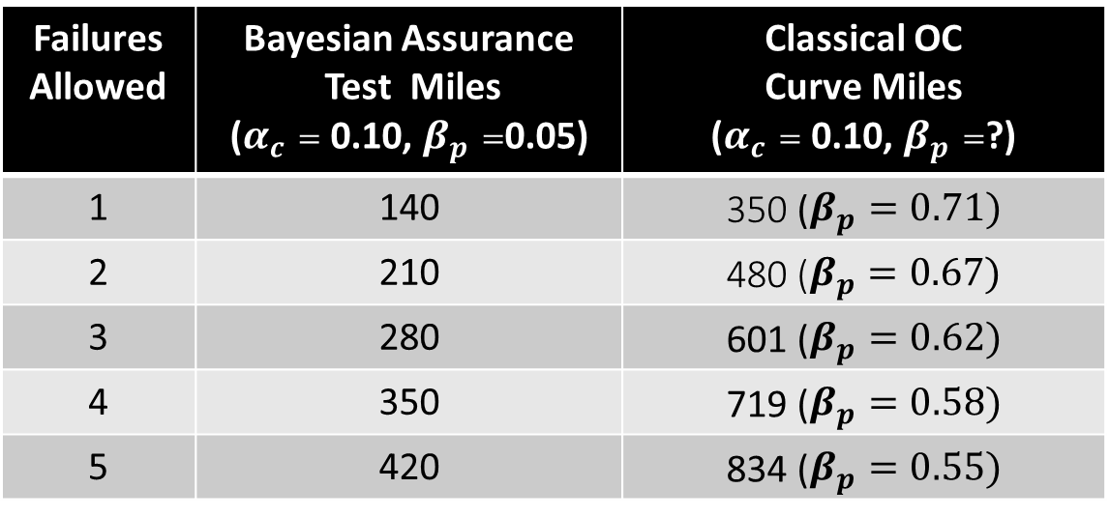
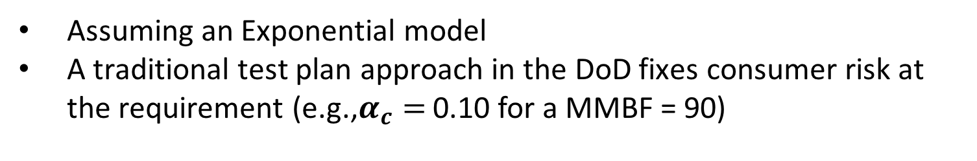
Case Study Test Plan Exponential
Assuming an Exponential model
A traditional test plan approach in the DoD fixes consumer risk at the requirement (e.g.,$α_{c}=$ 0.10 for a MMBF = 90)
Failures Allowed | Bayesian Assurance Test Miles ($α_{c}=$ 0.10, $β_{p}=$0.05) | Classical OC Curve Miles ($α_{c}=$ 0.10, $β_{p}=$?)
1 | 140 | 350 ($β_{p}=0.71)$
2 | 210 | 480 ($β_{p}=0.67)$
3 | 280 | 601 ($β_{p}=0.62)$
4 | 350 | 719 ($β_{p}=0.58)$
5 | 420 | 834 ($β_{p}=0.55)$

